Slide 1
Microservices Architecture

Slide 2
What is Software Architecture
Generically, architecture is the description of the set of components and the relationships between them
(Frank J. Armour, Stephen H. Kaisler, and Simon Y. Liu (1999). "A big-picture look at enterprise architectures." IT professional Vol 1 (1). p. 35-42.)
Architecture represents the significant design decisions that shape a system, where significant is measured by cost of change.
(Grady Booch (1991) Object-Oriented Design: with Applications. p. 320)
Notes:
https://en.wikiquote.org/wiki/Software_architecture

Slide 3




Architectural Style
An architectural style is a set of characteristics and features that make a structure notable or historically identifiable.

Slide 4
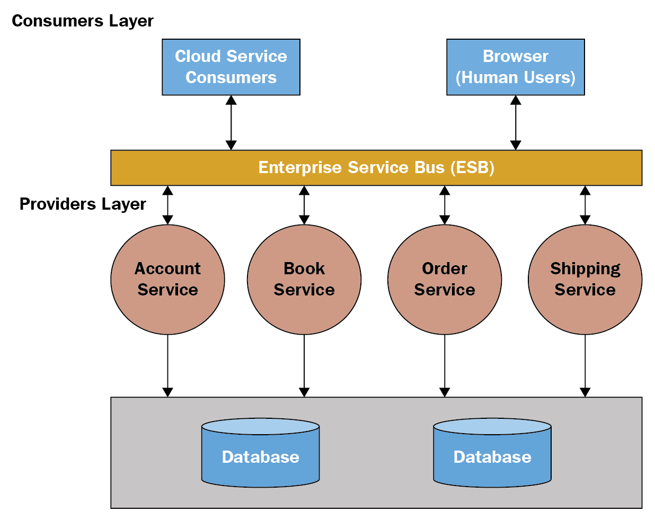
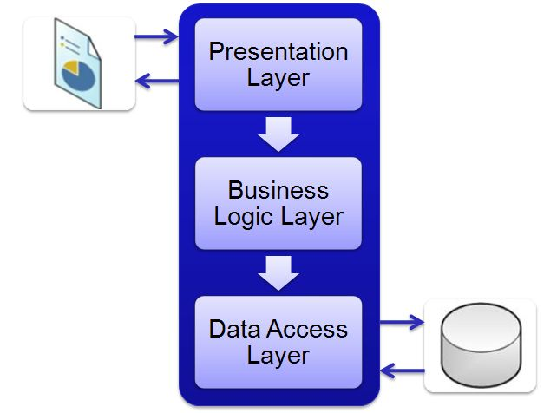
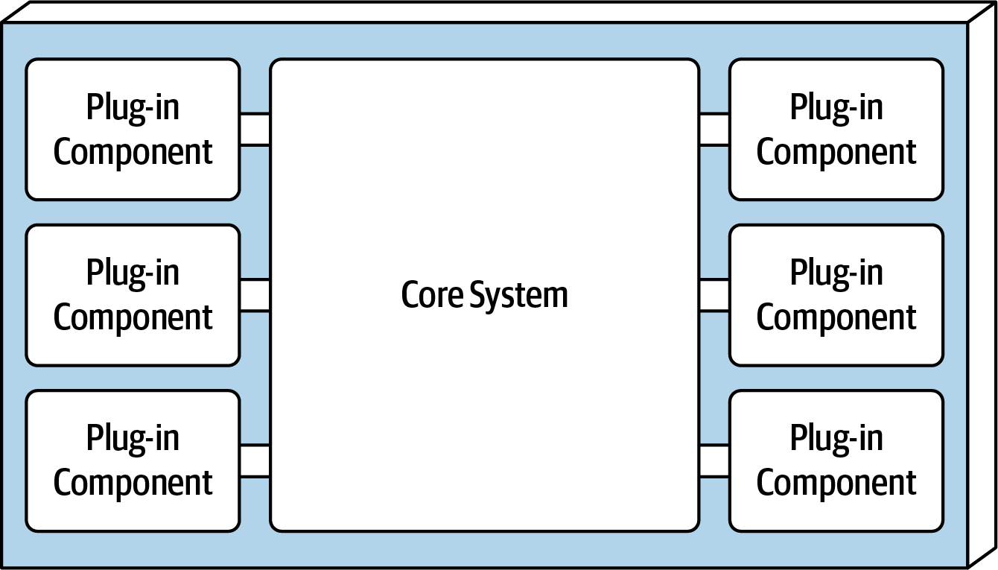
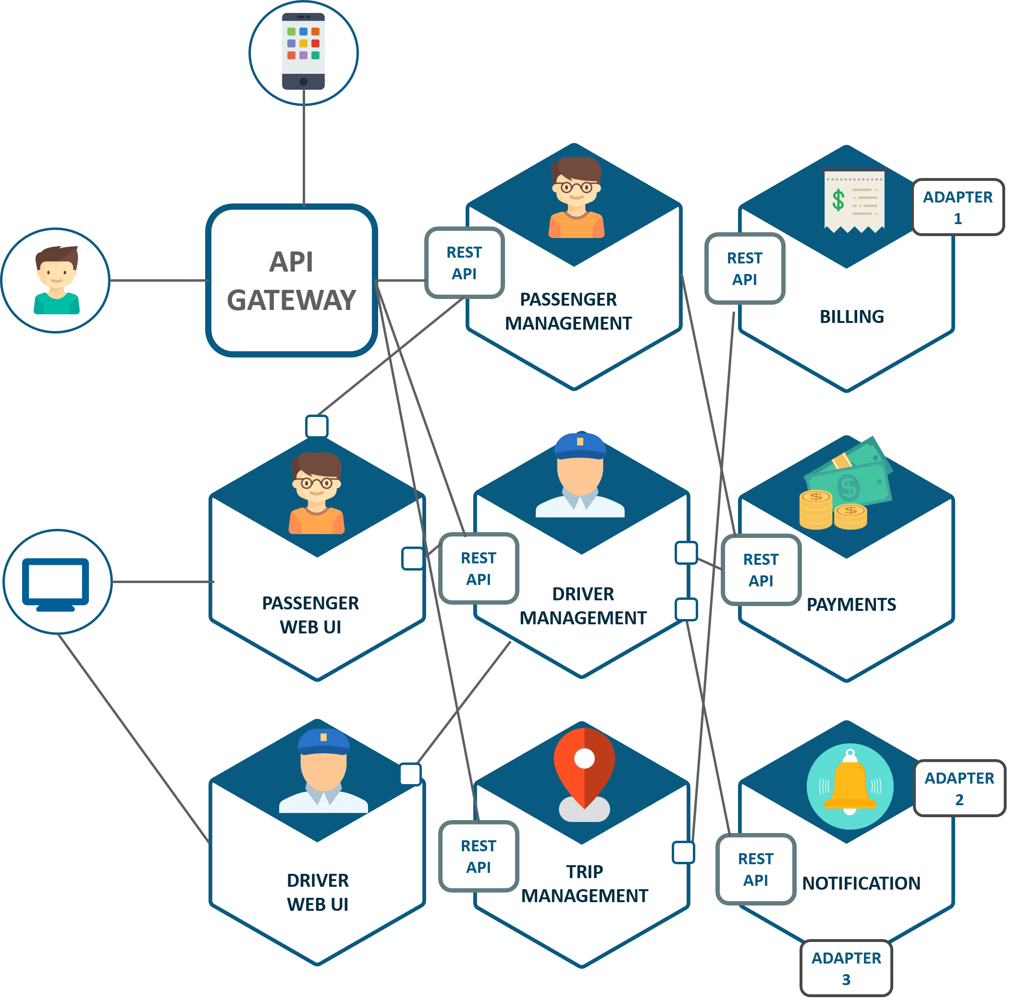

Software Architecture Style

Slide 5
Architectural Style Classification
Monolithic: single deployment unit(Process) of all code
Distributed: multiple deployment units connected through remote access protocols

Slide 6
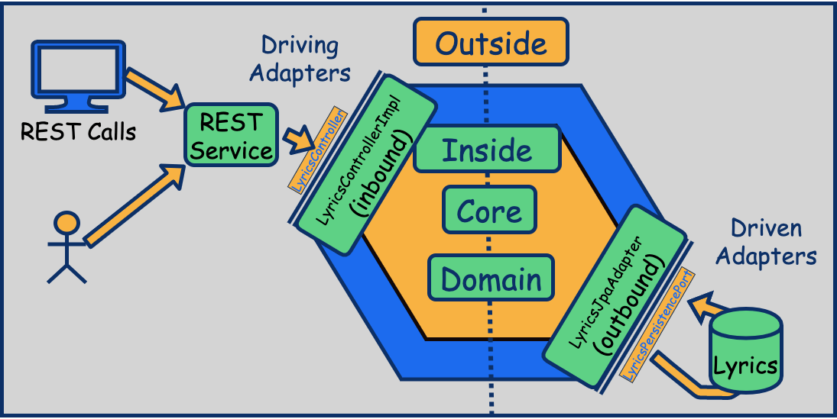
Monolith Architecture
Single Deployment
Single Process
Single Codebase

Slide 7
N-Tier(Layered) Architecture
Components within the layered architecture style are organized into logical horizontal layers, with each layer performing a specific role within the application (such as presentation logic or business logic)
The layered architecture style is a good choice for small, simple applications or websites. It is also a good architecture choice, particularly as a starting point, for situations with very tight budget and time constraints

Slide 8
Microkernel (Plugin) Architecture
The microkernel architecture style (also referred to as the plug-in architecture) was coined several decades ago and is still widely used today. This architecture style is a natural fit for product-based applications (packaged and made available for download and installation as a single,monolithic deployment, typically installed on the customer’s site as a third-party product

Slide 9
Pipe And Filter Architecture
Pipes in this architecture form the communication channel between filters. Each pipe is typically unidirectional and point-to-point (rather than broadcast) for performance reasons, acceptin input from one source and always directing output to another
Filters are self-contained, independent from other filters, and generally stateless. Filters should perform one task only g input from one source and always directing output to another

Slide 10
Service Oriented Architecture
SOA, or service-oriented architecture, defines a way to make software components reusable and interoperable via service interfaces. Services use common interface standards and an architectural pattern so they can be rapidly incorporated into new applications.
Notes:
https://www.oracle.com/technical-resources/articles/javase/soa.html
https://www.ibm.com/cloud/learn/soa#toc-what-is-so-pGpP4Puh

Slide 11
Service Oriented Architecture
SOA represents an important stage in the evolution of application development and integration over the last few decades. Before SOA emerged in the late 1990s, connecting an application to data or functionality housed in another system required complex point-to-point integration—integration that developers had to recreate, in part or whole, for each new development project. Exposing those functions through SOA services allowed the developer to simply reuse the existing capability and connect through the SOA ESB architecture
Notes:
https://www.oracle.com/technical-resources/articles/javase/soa.html
https://www.ibm.com/cloud/learn/soa#toc-what-is-so-pGpP4Puh

Slide 12
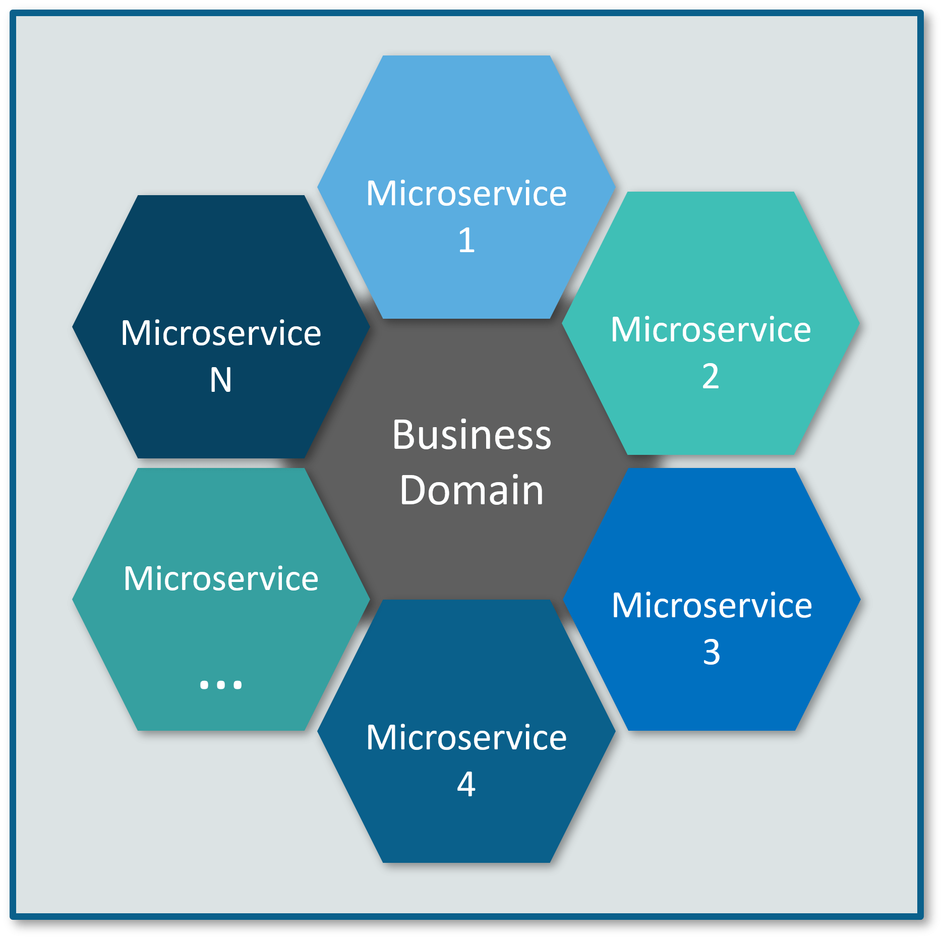
Microservices
The microservice architectural style is an approach to developing a single application as a suite of small services, each running in its own process and communicating with lightweight mechanisms, often an HTTP resource API, Async Messaging
Microservices are built around business capabilities and independently deployable by fully automated deployment machinery

Slide 13
What Are Microservices?
They are a type of service-oriented architecture (SOA), albeit one that is opinionated about how service boundaries should be drawn, and that independent deploy ability is key.
Microservices also have the advantage of being technology agnostic

Slide 14
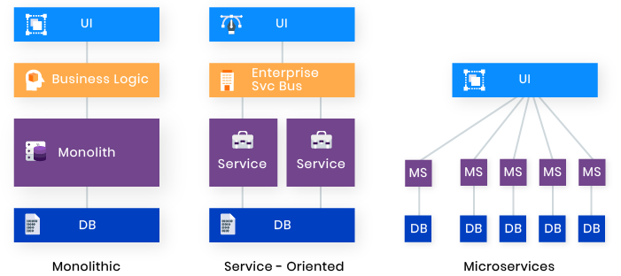
Monolith, Distributed (SOA, Microservices)

Slide 15
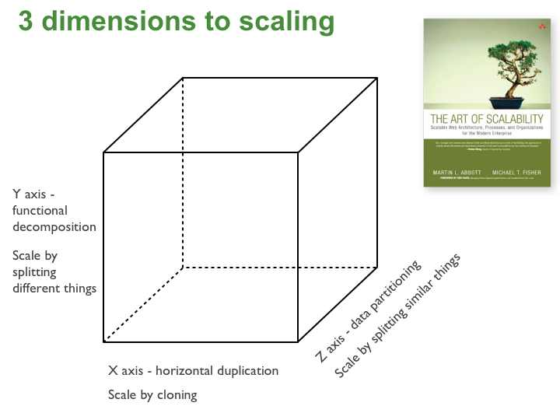
Scaling Cube

Slide 16
X-axis
X-axis scaling consists of running multiple copies of an application behind a load balancer. If
there are N copies then each copy handles 1/N of the load. This is a simple, commonly used
approach of scaling an application.
One drawback of this approach is that because each copy potentially accesses all of the data, caches require more memory to be effective. Another problem with this approach is that it does not tackle the problems of increasing development and application complexity.

Slide 17
Y-axis
Unlike X-axis and Z-axis, which consist of running multiple, identical copies of the application, Y-axis axis scaling splits the application into multiple, different services. Each service is responsible for one or more closely related functions. There are a couple of different ways of decomposing the application into services. One approach is to use verb-based decomposition and define services that implement a single use case such as checkout. The other option is to decompose the application by noun and create services responsible for all operations related to a particular entity such as customer management. An application might use a combination of verb-based and noun-based decomposition.

Slide 18
Z-axis
When using Z-axis scaling each server runs an identical copy of the code. In this respect, it’s similar to X-axis scaling. The big difference is that each server is responsible for only a subset of the data. Some component of the system is responsible for routing each request to the appropriate server. One commonly used routing criteria is an attribute of the request such as the primary key of the entity being accessed. Another common routing criteria is the customer type. For example, an application might provide paying customers with a higher SLA than free customers by routing their requests to a different set of servers with more capacity.

Slide 19
Z-axis - Sample
Z-axis splits are commonly used to scale databases. Data is partitioned (a.k.a. sharded) across a set of servers based on an attribute of each record. In this example, the primary key of the RESTAURANT table is used to partition the rows between two different database servers. Note that X-axis cloning might be applied to each partition by deploying one or more servers as replicas/slaves. Z-axis scaling can also be applied to applications. In this example, the search service consists of a number of partitions. A router sends each content item to the appropriate partition, where it is indexed and stored. A query aggregator sends each query to all of the partitions, and combines the results from each of them.

Slide 20
Z-axis - Benefit
Each server only deals with a subset of the data.
This improves cache utilization and reduces memory usage and I/O traffic.
It also improves transaction scalability since requests are typically distributed across multiple servers.
Also, Z-axis scaling improves fault isolation since a failure only makes part of the data in accessible.

Slide 21
Z-axis - Drawbacks
One drawback is increased application complexity.
We need to implement a partitioning scheme, which can be tricky especially if we ever need to repartition the data.
Another drawback of Z-axis scaling is that doesn’t solve the problems of increasing development and application complexity. To solve those problems we need to apply Y-axis scaling.

Slide 22
Monolith Architecture

Slide 23
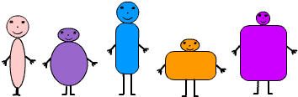
Monolith Variations

Slide 24
Modular Monolith
As a subset of the single process monolith, the modular monolith is a variation: the single process consists of separate modules, each of which can be worked on inde‐pendently, but which still need to be combined for deployment

Slide 25
Distributed Monolith
A distributed monolith is a system that consists of multiple services, but for whatever reason the entire system has to be deployed together

Slide 26

Advantage of Monolith

Slide 27
Advantage of Monolith
Simple to develop IDEs and other developer tools are focused on building a single application
Easy to make radical changes to the application You can change the code and the database schema, build, and deploy
Straightforward to test The developers wrote end-to-end tests that launched the application, invoked the REST API, and tested the UI with Selenium

Slide 28
Advantage of Monolith
Straightforward to deploy All a developer had to do was copy the WAR file to a server that had Tomcat installed
Easy to scale multiple instances of the application behind a load balancer
Simplify code reuse within the monolith itself(same codebase, same programing language,…)

Slide 29

Disadvantage of Monolith

Slide 30
Complexity Intimidates developers
Large code developers wanting to change the same piece of code ,different teams wanting to push functionality live at different times
It’s too large for any developer to fully understand .as a result, fixing bugs and correctly implementing new features have become difficult and time consuming. Easy to scale—FTGO ran multiple instances of the application behind a load balancer
Monoliths can also simplify code reuse within the monolith itself

Slide 31
Development is Slow
Developers find day-to-day development tasks slow. The large application overloads and slows down a developer’s IDE.
Building the application takes a long time.
Moreover, because it’s so large, the application takes a long time to start up

Slide 32
Scaling is Difficult
That’s because different application modules have conflicting resource requirements. Some module persist their data in memory, some module need to CPU Process.

Slide 33
Interoperability
Redeveloped or duplicated existing functionality or had to know how to connect or provide interoperability with existing functions

Slide 34


Interoperability In Enterprise

Slide 35
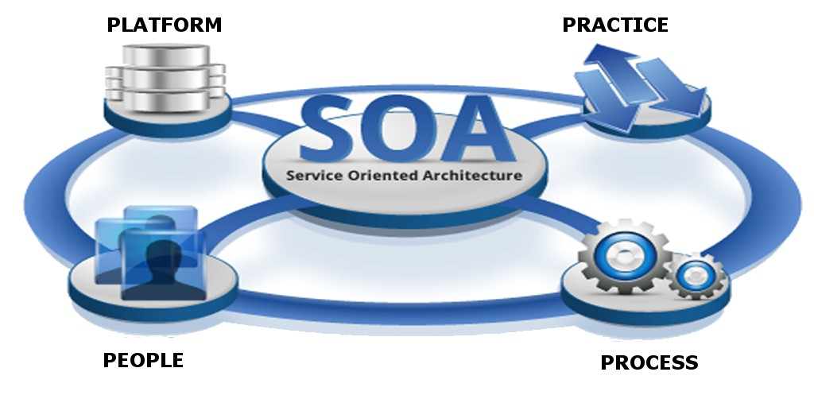

Slide 36
Microservices
Principles
Notes:
Microservices in action – page 7

Slide 37

Autonomy
Each service operates and changes independently of others
Notes:
Each Service develop, deploy and work independently

Slide 38
Autonomy
Loosely coupled : Enables a team to work independently the majority of time on their service(s) without being impacted by changes to other services and without affecting other services
Independently deployable : Enables a team to deploy their service without having to coordinate with other teams

Slide 39

Recilience
Microservices are a natural mechanism for isolating failure: if you deploy them independently, application or infrastructure failure may only affect part of your system

Slide 40

Transparency
Most importantly, you need to know when a failure has occurred, and rather than one system, a microservice application depends on the interaction and behavior of multiple services, possibly built by different teams. At any point, your system should be transparent and observable to ensure that you both observe and diagnose problems.
Every service in your application will produce business, operational, and infrastructure metrics; application logs; and request traces. As a result, you’ll need to make sense of a huge amount of data.

Slide 41
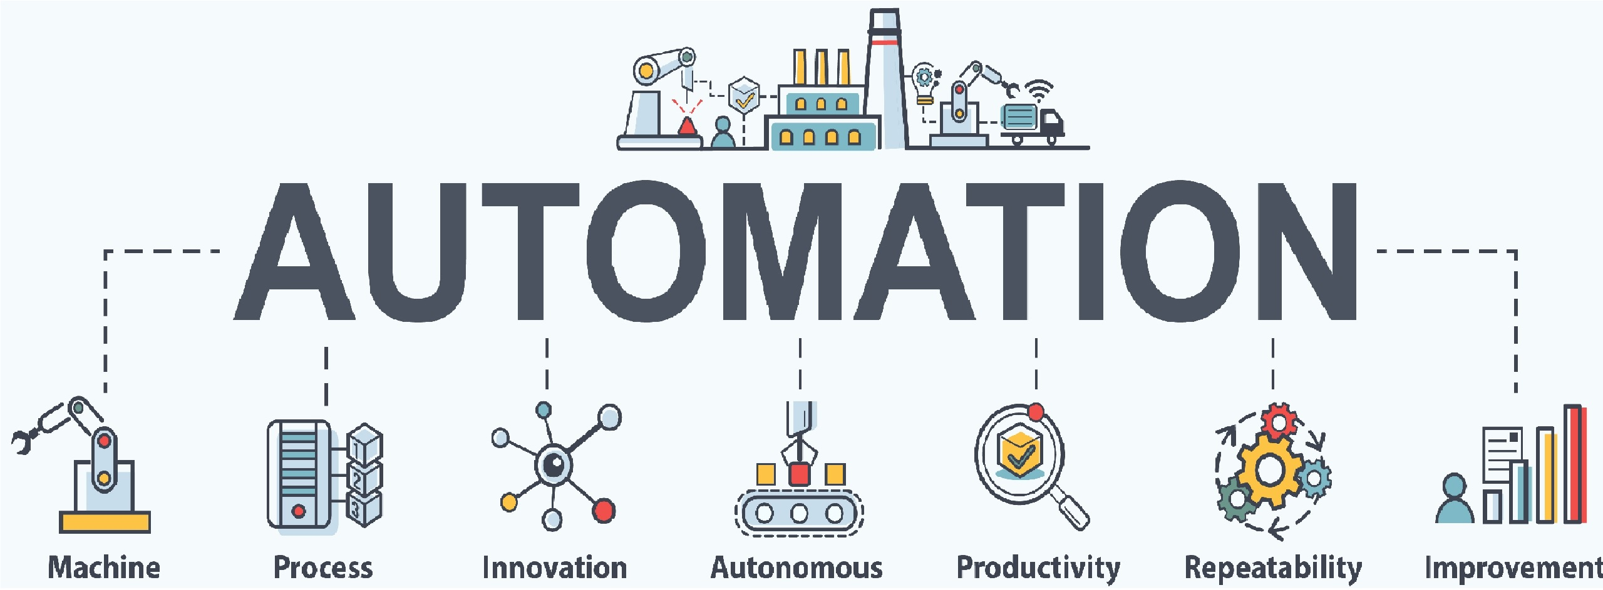
Automation
Microservices are a more complex architecture than building a single application. By embracing automation and seeking consistency in the infrastructure between services, you can significantly reduce the cost of managing this additional complexity.
You need to use automation to ensure the correctness of deployments and system operation

Slide 42

Alignment
In microservice architecture, each service should align to a single business capability, encapsulating all relevant technical layers

Slide 43
Advantage of Microservices

Slide 44
Advantage of Microservices
It enables the continuous delivery and deployment of large, complex applications.
Services are small and easily maintained.
Services are independently deployable.
Services are independently scalable.
The microservice architecture enables teams to be autonomous.
It allows easy experimenting and adoption of new technologies.
It has better fault isolation

Slide 45
It enables the continuous delivery and deployment of large, complex applications
It has the testability required by continuous delivery/deployment
Automated testing is a key practice of continuous delivery/deployment. Because each service in a microservice architecture is relatively small, automated tests are much easier to write and faster to execute. As a result, the application will have fewer bugs

Slide 46
It enables the continuous delivery and deployment of large, complex applications
It has the deployability required by continuous delivery/deployment
Each service can be deployed independently of other services. If the developers responsible for a service need to deploy a change that’s local to that service, they don’t need to coordinate with other developers. They can deploy their changes. As a result, it’s much easier to deploy changes frequently into production.

Slide 47
It enables the continuous delivery and deployment of large, complex applications
It enables development teams to be autonomous and loosely coupled
You can structure the engineering organization as a collection of small (for example, two-pizza) teams. Each team is solely responsible for the development and deployment of one or more related services. each team can develop, deploy, and scale their services independently of all the other teams. As a result, the development velocity is much higher.

Slide 48
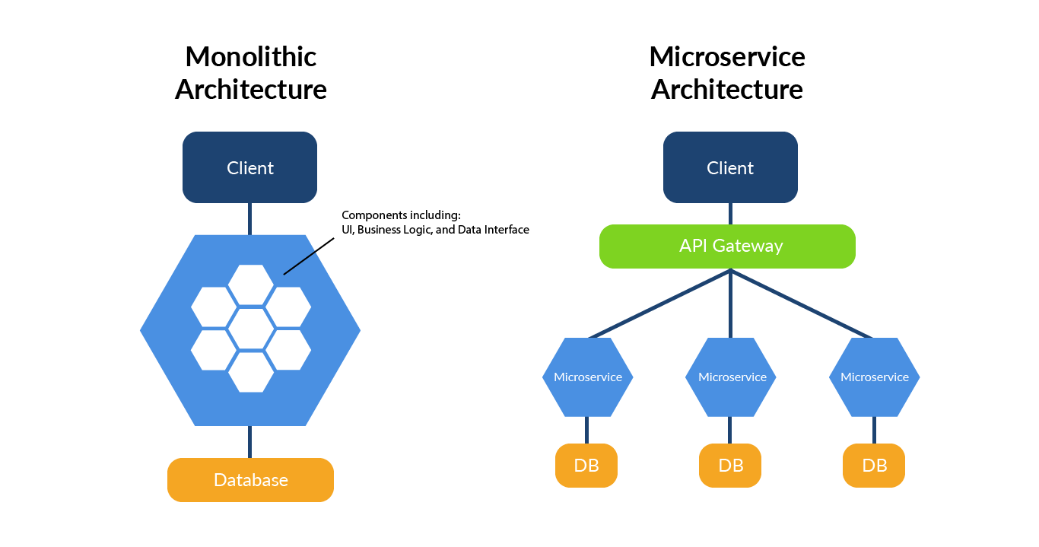
Services are small and easily maintained
The code is easier for a developer to understand. The small code base doesn’t slow down the IDE, making developers more productive. And each service typically starts a lot faster than a large monolith does, which also makes developers more productive and speeds up deployments.

Slide 49
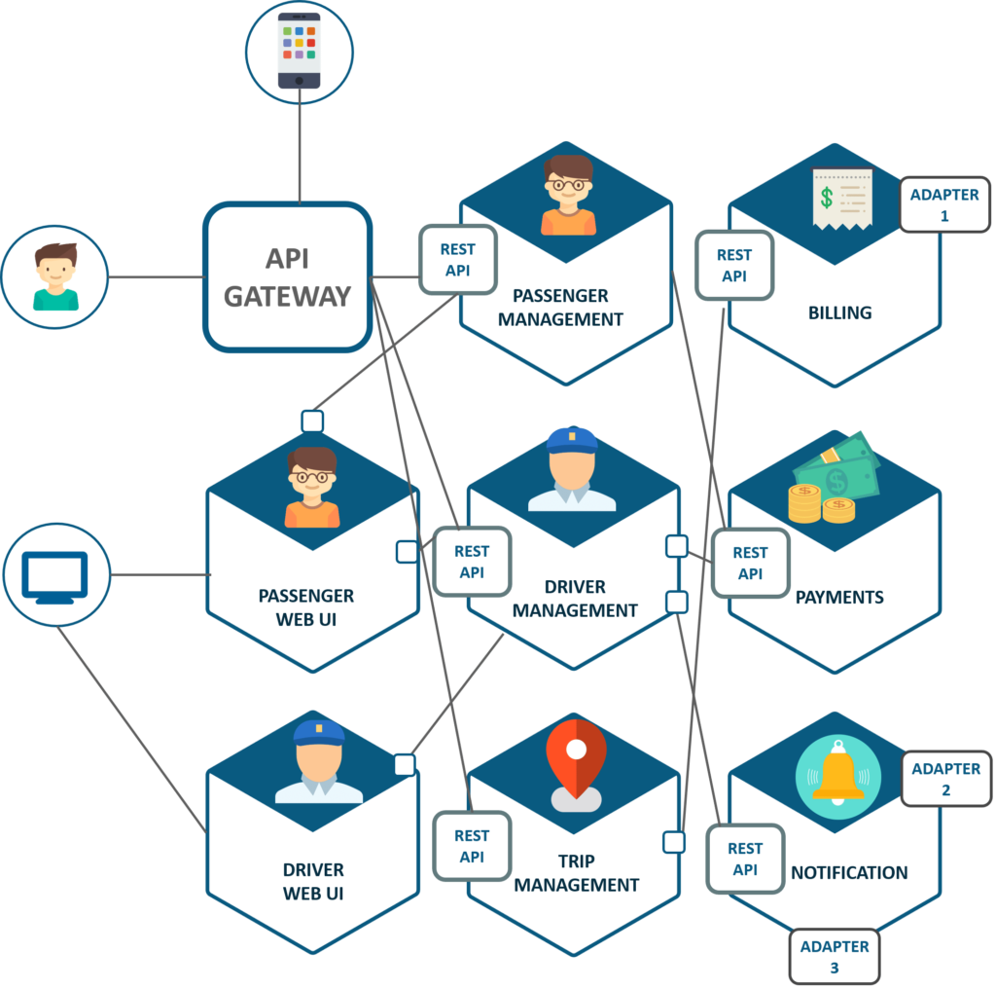
Services are independently deployable.
Each service in a microservice architecture can be scaled independently of other services using X-axis cloning and Z-axis partitioning. Moreover, each service can be deployed on hardware that’s best suited to its resource requirements. This is quite different than when using a monolithic architecture, where components with wildly different resource requirements for example, CPU-intensive vs. memory-intensive must be deployed together.

Slide 50
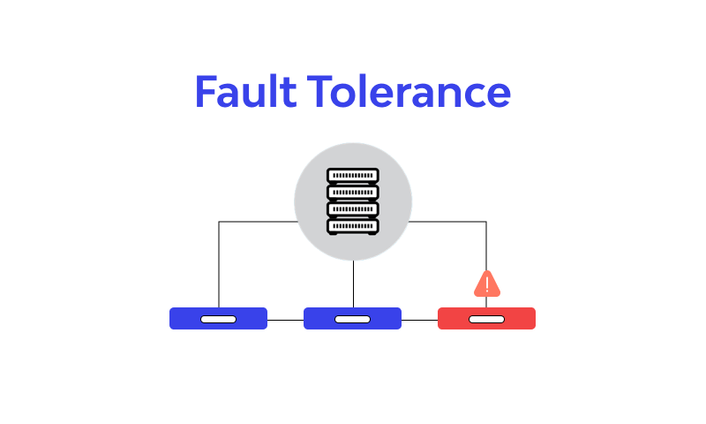
It has better fault isolation
The microservice architecture has better fault isolation. For example, a memory leak in one service only affects that service. Other services will continue to handle requests normally. In comparison, one misbehaving component of a monolithic architecture will bring down the entire system.

Slide 51

It allows easy adoption of new technologies.
microservice architecture eliminates any long-term commitment to a technology stack. In principle, when developing a new service, the developers are free to pick whatever language and frameworks are best suited for that service

Slide 52
Disadvantage of Microservices

Slide 53
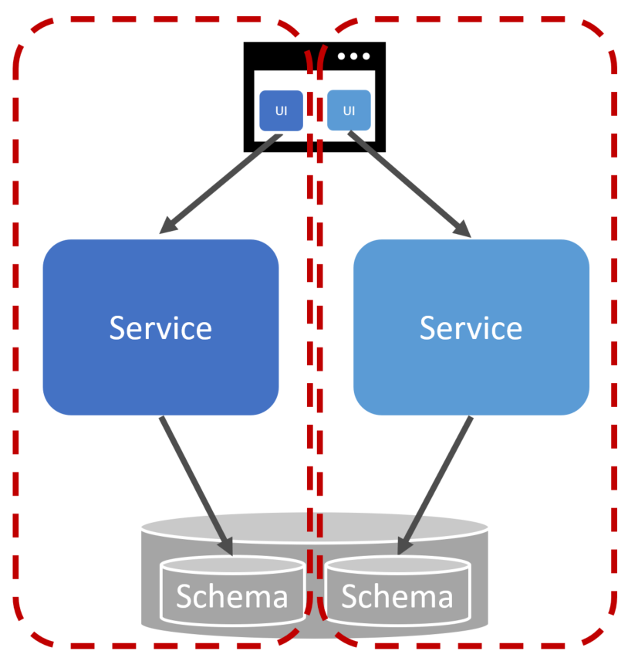
FINDING THE RIGHT SERVICES IS CHALLENGING
One challenge with using the microservice architecture is that there isn’t a concrete, well-defined algorithm for decomposing a system into services. As with much of software development, it’s something of an art. To make matters worse, if you decompose a system incorrectly, you’ll build a distributed monolith, a system consisting of coupled services that must be deployed together.
A distributed monolith has the drawbacks of both the monolithic architecture and the microservice architecture

Slide 54

DISTRIBUTED SYSTEMS ARE COMPLEX
Another issue with using the microservice architecture is that developers must deal with the additional complexity of creating a distributed system.
Services must use an interprocess communication mechanism. This is more complex than a simple method call.
Moreover, a service must be designed to handle partial failure and deal with the remote service either being unavailable or exhibiting high latency
Notes:
Debug, Trace
Martin Fowler : My First Law of Distributed Object Design: Don't distribute your objects

Slide 55

DEPLOYING FEATURES SPANNING MULTIPLE SERVICES NEEDS CAREFUL COORDINATION
Another challenge with using the microservice architecture is that deploying features that span multiple services requires careful coordination between the various development teams.
You have to create a rollout plan that orders service deployments based on the dependencies between services. That’s quite different than a monolithic architecture, where you can easily deploy updates to multiple components atomically
Notes:
Pass a use case need to multiple service

Slide 56

DECIDING WHEN TO ADOPT IS DIFFICULT
Another issue with using the microservice architecture is deciding at what point during the lifecycle of the application you should use this architecture.
When developing the first version of an application, you often don’t have the problems that this architecture solves. Moreover, using an elaborate, distributed architecture will slow down development.
A startup should almost certainly begin with a monolithic application

Slide 57

Developer Experience
As you have more and more services, the developer experience can begin to suffer. More resource-intensive runtimes like the JVM can limit the number of microservices that can be run on a single developer machine

Slide 58

Technology Overload
Microservices may well give you the option for each microservice to be written in a different programming language, to run on a different runtime, or to use a different database—but these are options, not requirements. You have to carefully balance the breadth and complexity of the technology you use against the costs that a diverse array of technology can bring.

Slide 59

Technology Overload
Run more things
More processes
More computers
More network
More storage
More supporting software
Note : Microservices are a poor choice for an organization primarily concerned with reducing costs, as a cost-cutting mentality

Slide 60
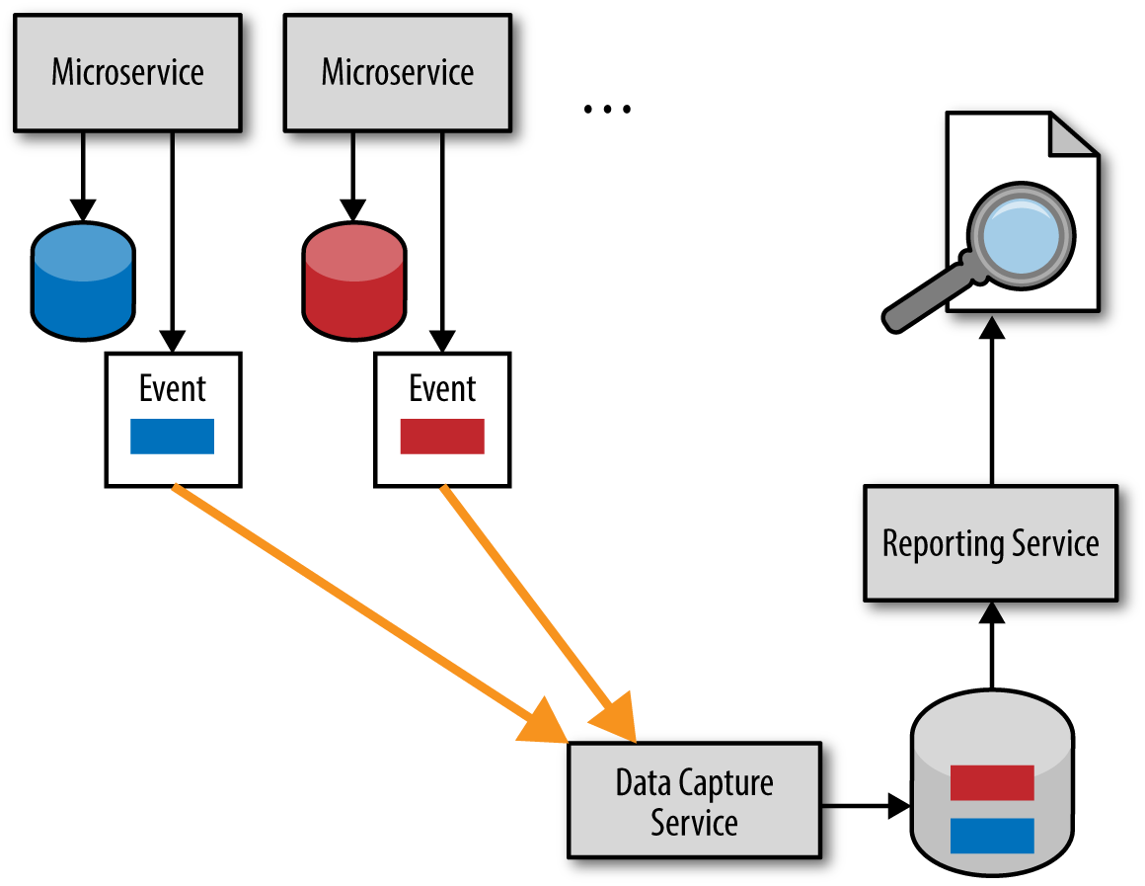
Reporting
With a monolithic system, you typically have a monolithic database With a microservice architecture, we have broken up this monolithic schema. That doesn’t mean that the need for reporting across all our data has gone away; we’ve just made it much more difficult, because now our data is scattered across multiple logically isolated schemas

Slide 61
Reporting
With a monolithic system, you typically have a monolithic database With a microservice architecture, we have broken up this monolithic schema. That doesn’t mean that the need for reporting across all our data has gone away; we’ve just made it much more difficult, because now our data is scattered across multiple logically isolated schemas

Slide 62
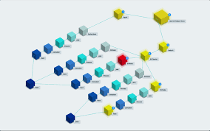
Monitoring and Troubleshooting
With a standard monolithic application, we can have a fairly simplistic approach to monitoring. We have a small number of machines to worry about, and the failure mode of the application is somewhat binary—the application is often either all up or all down.
With a microservice architecture with tens or hundreds of processes, can we say the same thing?

Slide 63

Latency
With a microservice architecture, processing that might previously have been done locally on one processor can now end up being split across multiple separate microservices. Information that previously flowed within only a single process now needs to be serialized, transmitted, and deserialized over networks that you might be exercising more than ever before

Slide 64

No Silver Bullet

Slide 65

Communication

Slide 66
Interaction style
One-to-one—Each client request is processed by exactly one service.
One-to-many—Each request is processed by multiple services
Synchronous—The client expects a timely response from the service and might even block while it waits.
Asynchronous—The client doesn’t block, and the response, if any, isn’t necessarily sent immediately

Slide 67
One to One
Request / Response
A service client makes a request to a service and waits for a response. The client expects the response to arrive in a timely fashion. It might event block while waiting. This is an interaction style that generally results in services being tightly coupled

Slide 68
One to One
Asynchronous request/response A client sends a request to a service, which replies asynchronously. The client doesn’t block while waiting, because the service might not send the response for a long time
Notes:
https://reflectoring.io/amqp-request-response/

Slide 69
One to One
One-Way Notification A client sends a request to a service, but no reply is expected or sent.

Slide 70
One To Many
Publish/subscribe A client publishes a notification message, which is consumed by zero or more interested services.
Publish/async Response A client publishes a request message and then waits for a certain amount of time for responses from interested services

